Slide 1
IMPLEMENTATION OF CONVOLUTIONAL CODING AND VITERBI DECODER
13BEC1138 – Shraddha Agrawal
13BEC1100 – Prithvish V N
13BEC1009 – Priyamvada kundu

Slide 2
CONVOLUTIONAL CODING
Convolutional codes are widely used as channel codes in practical communication systems for error correction.
Most commonly used for :
Popular wireless standards (such as 802.11)
Satellite communication
Used in space missons such as :
Mars Pathfinder
Mars Exploration Rover
Cassini Probe to Saturn
Definition :
In telecommunication, convolutional coding is a type of error correcting codes that generates parity symbols via the sliding application of a Boolean polynomial function to a data stream.
- wikipedia

Slide 3
PARAMETERS :
Convolutional codes are described using two parameters :
Code rate
Constraint length
The code rate, k/n, is expressed as a ratio of the number of bits into the convolutional encoder (k) to the number of channel symbols output by the convolutional encoder (n) in a given encoder cycle.
If a convolutional code produces r parity bits per window and slides the window forward by one bit at a time, its rate is 1/r.
The constraint length parameter, K, denotes the "length" of the convolutional encoder, i.e. how many k-bit stages are available to feed the combinatorial logic that produces the output symbols.
The size of the window, in bits, is called the coder’s constraint length.
Closely related to K is the parameter m, which indicates how many encoder cycles an input bit is retained and used for encoding after it first appears at the input to the convolutional encoder. The m parameter can be thought of as the memory length of the encoder.

Slide 4
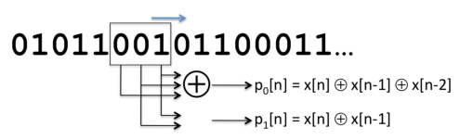
An example of a convolutional code with code rate ½ and constraint length 3.
Encoding process :
The encoder looks at K bits at a time and produces r parity bits according to carefully chosen functions that operate over various subsets of the K bits.
The encoder spits out r bits, which are sent sequentially, slides the window by 1 to the right, and then repeats the process.
By convention, we will assume that each message has K - 1 “0” bits padded in front, so that the initial conditions work out properly

Slide 5

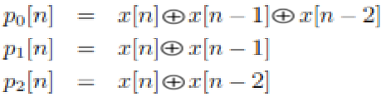
Parity equations :
The example shows one example of a set of parity equations, which govern the way in which parity bits are produced from the sequence of message bits, X. These are :
An example of parity equations for a rate 1/3 code is :
In general, one can view each parity equation as being produced by composing the message bits, X, and a generator polynomial, g.
In the ﬁrst example above, the generator polynomial coefﬁcients are (1, 1, 1) and (1, 1, 0), while in the second, they are (1, 1, 1), (1, 1, 0), and (1, 0, 1).

Slide 6
Work out example:
Generator polynomial : g0 = 1,1,1
g1 = 1,1,0
For the message sequence, X = [1,1,0,1,0,0], then the generated parity bits would be
(consider + as XOR operation)
p0[0] = 1+0+0 = 1
p0[1] = 1+0 = 1
p1[0] = 1+1+0 = 0
p1[1] = 1+1 = 0
p2[0] = 0+1+1 = 0
p2[1] = 0+1 = 1
p3[0] = 1+0+1 = 0
p3[1] = 1+0 = 1
p4[0] = 0+1+0 = 1
p4[1] = 0+1 = 1
p5[0] = 0+0+1 = 1
p5[1] = 0+0 = 0
Therefore the parity bits sent over the channel are [1,1,0,0,0,1,0,1,1,1,1,0]

Slide 7
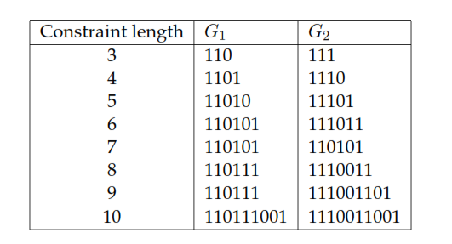
At the transmitter, the only remaining details that we have to worry about now are:
1. What are good parity functions and how can we represent them conveniently?
2. How can we implement the encoder efﬁciently?
There are several generator polynomials; however all of them do not result in output sequences that have good error protection properties.
Example for generator polynomial for rate ½ convolutional codes with different constraint lengths : (found by J. Busgang)

Slide 8
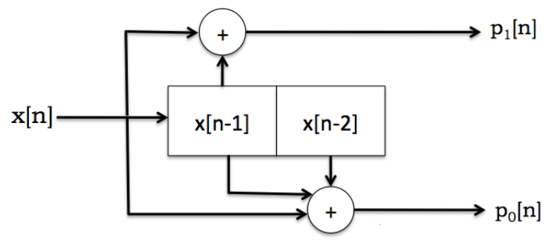
Block diagram view of convolutional codes :
Block diagram of convolutional codes using shift registers
Input message bits, x[n], arrive on the wire from the left.
The box calculates the parity bits using the incoming bits and the state of the encoder (the k - 1 previous bits; 2 in this example).
After the r parity bits are produced, the state of the encoder shifts by 1, with x[n] taking the place of x[n-1], x[n-1] taking the place of x[n-2], and so on, with x[n-K +1] being discarded. This block diagram is directly amenable to a hardware implementation using shift registers.

Slide 9
State machine view :
State machine corresponds to a view of the encoder as a set of states with well- deﬁned transitions between them.
The state machine for a convolutional code is identical for all codes with a given constraint length, K
The number of states is always 2^{K-1}.
Only the p labels change depending on the number of generator polynomials and the values of their coefﬁcients.
Each state is labeled with x[n - 1]x[n - 2] ...x[n - K + 1].
Each arc is labeled with x[n]/p0p1.

Slide 10
Transition table :
Input x[n] | Present State x[n-1] x[n-2] |  | Output p0[n] p1[n] |  | Next State x[n-1] x[n-2]
0 | 0 | 0 | 0 | 0 | 0 | 0
1 | 0 | 0 | 1 | 1 | 1 | 0
0 | 0 | 1 | 1 | 0 | 0 | 0
1 | 0 | 1 | 0 | 1 | 1 | 0
0 | 1 | 0 | 1 | 1 | 0 | 1
1 | 1 | 0 | 0 | 0 | 1 | 1
0 | 1 | 1 | 0 | 1 | 0 | 1
1 | 1 | 1 | 1 | 0 | 1 | 1

Slide 11
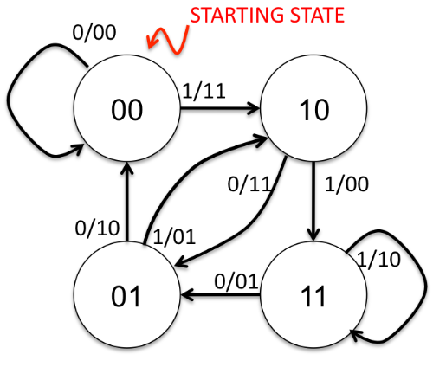
State diagram :
This state machine view is an elegant way to explain what the transmitter does, and also what the receiver ought to do to decode the message.
The transmitter begins in the initial state (labeled “STARTING STATE”) and processes the message one bit at a time. For each message bit, it makes the state transition from the
current state to the new one depending on the value of the input bit, and sends the parity
bits that are on the corresponding arc.
The receiver, of course, does not have direct knowledge of the transmitter’s state transitions. It only sees the received sequence of parity bits, with possible corruptions. Its task is to determine the best possible sequence of transmitter states that could have produced the parity bit sequence.

Slide 12
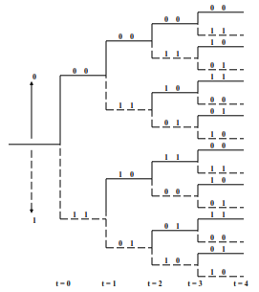
Tree diagram representation :
The tree diagram representation shows all possible information and encoded sequences for the convolutional encoder.
The encoded bits are labeled on the branches of the tree.
Given an input sequence, the encoded sequence can be directly read from the tree.
As an example,
an input sequence (1011) results in the encoded sequence (11, 10, 00, 01).

Slide 13
MATLAB Code for convolutional encoder :
%%%% convolutional encoding %%%%
clc
clear all
msg=input('Enter the msg signal for convolutional decoding = ');
r=input('Enter r value for rate 1/r = ');
K=input('Enter the window size = ');
m=K-1; %memory
msg=[zeros(1,m),msg];
encoded=[];
g=[];
for i=1:r
q=input('Enter the generator polynomial of size same as the window size = ');
q=fliplr(q);
g=[g;q];
end
for i=1:length(msg)-2
for j=1:r
k=msg(i:i+2).*g(j,:);
for l=1:2
k(1)=xor(k(1),k(1+l));
n=k(1);
end
encoded=[deco,n];
end
end
encoded

Slide 14
The decoding problem :
The receiver should determine the “best possible” sequence of transmitter states.
A decoder that is able to infer the most likely sequence (i.e., message bits) that must have been traversed (sent) by the transmitter is also called a maximum likelihood decoder.
Consider a simple numerical example. Suppose that bit errors are independent
and identically distribute with a BER of 0.001, and that the receiver digitizes a sequence
of analog samples into the bits 1101001. Is the sender more likely to have sent 1100111
or 1100001?
The ﬁrst has a Hamming distance of 3, and the probability of receiving that
sequence is (0.999) 4(0.001)3=9.9 × 106. The second choice has a Hamming distance of
1 and a probability of (0.999) (0.001)1-10=9.9 × 10-4, which is six orders of magnitude higher
and is overwhelmingly more likely.
Conclusion :
Thus, the most likely sequence of parity bits that was transmitted must be the one with
the smallest Hamming distance from the sequence of parity bits received. Given a choice
of possible transmitted messages, the decoder should pick the one with the smallest such
Hamming distance

Slide 15
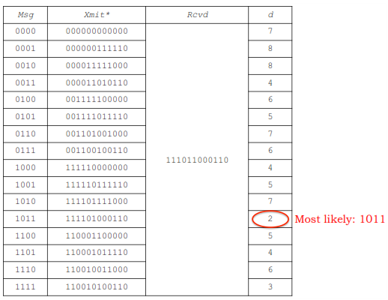
When the probability of bit error is less than 1/2, maximum likelihood decoding boils down to ﬁnding the message whose parity bit sequence, when transmitted, has the smallest Hamming distance to the received sequence. Ties may be broken arbitrarily.
Unfortunately, for an N-bit transmit sequence, there are 2 possibilities, which makes it hugely intractable to simply go through in sequence tbecause of the sheer number. For instance, when N =256bits (a really small packet), the number of possibilities rivals the number of atoms in the universe!

Slide 16
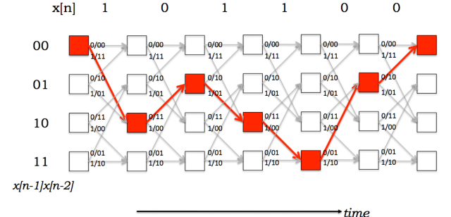
The Trellis
The trellis is a structure derived from the state machine that will allow us to develop an efﬁcient way to decode convolutional codes. The state machine view shows what happens at each instant when the sender has a message bit to process, but doesn’t show how the
system evolves in time. The trellis is a structure that makes the time evolution explicit.
Each column of the trellis has the set of states
Each state in a column is connected to two states in the next column—the same two states in the state diagram.
The top link from each state in a column of the trellis shows what gets transmitted on a “0”, while the bottom shows what gets transmitted on a “1”.

Slide 17
If we decode this received bit sequence, the decoding process is termed
hard decision decoding.
If we decode the voltage samples directly before digitizing them, we term the process soft decision decoding.
The Viterbi decoder can be used in either case.
Intuitively, because hard decision decoding makes an “early” decision regarding whether a bit is 0 or 1, it throws away information in the digitizing. It might make a wrong digitizing decision, especially for voltages near the threshold, introducing a greater number of bit errors in the received bit sequence. Although it still produces the most likely transmitted sequence, by introducing additional errors in the early digitization, the overall reduction in BER is less than with soft decision decoding.

Slide 18
Suppose we have the entire trellis in front of us for a code, and now receive a sequence of digitized bits (or voltage samples).
If there are no errors (or if noise were low), then
there will be some path through the states of the trellis that would exactly match up with the received sequence.
That path (speciﬁcally, the concatenation of the encoding of each state along the path) corresponds to the transmitted parity bits.
From there, getting to the original message is easy because the top arc emanating from each node in the trellis corresponds to a “0” bit and the bottom arrow corresponds to a “1” bit.
When there are errors,
ﬁnding the most likely transmitted message sequence is appealing because it minimizes the BER.
the path with the smallest accumulation of errors is the path we want, and the transmitted message sequence can be easily determined by the concatenation of states explained above.

Slide 19
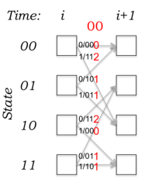
The Viterbi Decoder
The decoding algorithm uses two metrics:
the branch metric (BM)
the path metric (PM).
The branch metric is a measure of the “distance” between what was transmitted and
what was received, and is deﬁned for each arc in the trellis.
In hard decision decoding, where we are given a sequence of digitized parity bits, the branch metric is the Hamming distance between the expected parity bits and the received ones

Slide 20
The key insight in the Viterbi algorithm is that the receiver can compute the path metric for a (state, time) pair incrementally using the path metrics of previously computed states and the branch metrics.
The value of PM[s, i] is the total number of bit errors detected when comparing the received parity bits to the most likely transmitted message, considering all messages that could have been sent by the k-1 transmitter until time step i.
(starting from state “00”, which we will take by convention to be the starting state always)
PM[s, i + 1] = min(PM[a, i]+BM[a →s], PM[ß, i]+BM[ß →s]), (9.1)
where a and ß are the two predecessor states.

